Slide 1


Mongo DB
By Group One:
Okeke Onyedikachukwu, Babatunde Odumuyiwa, Maduabughichi Achilefu

Slide 2
Project Overview
Phase I
Introduction and History of MongoDB
Phase II
Market Share Analysis
Phase III
MongoDB Vs Other NoSQL DB’s

Slide 3

Phase I
Introduction and History of MongoDB

Slide 4

Introduction

Slide 5

Built for the way you work with data
MongoDB is an open source document model database enables developers to store data as JSON-like objects that resemble objects in application code. MongoDB Atlas allows the use of preferred tools and languages to manage clusters with MongoDB CLI for Atlas, or IaC tools like Terraform or Cloudformation.

Slide 6


History of MongoDB
MongoDB is a NoSQL database that was developed by 10gen, a company founded by Dwight Merriman and Eliot Horowitz in 2007.
The first version of MongoDB was released in 2009, and it quickly gained popularity among developers due to its ease of use, scalability, and flexibility.

Slide 7
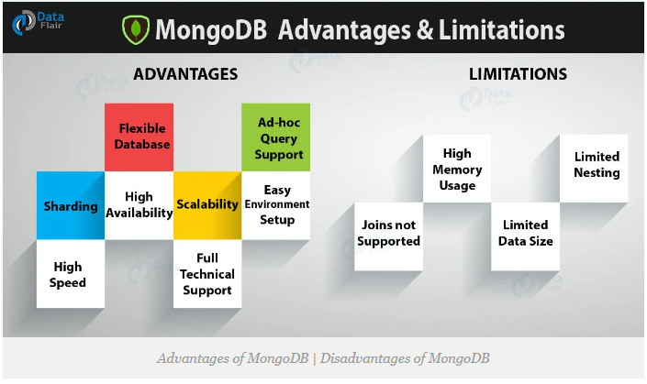
Pros
Cons

Slide 8

Phase II
Market Share Analysis

Slide 9
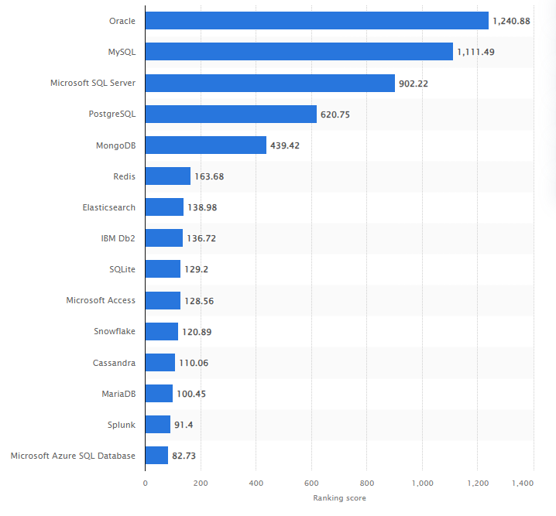
MongoDB vs Other Databases Market Share
As at 30th September 2023, Mongo DB ranks 5th among most popular database management systems worldwide.
Source: https://www.statista.com/statistics/809750/worldwide-popularity-ranking-database-management-systems/

Slide 10
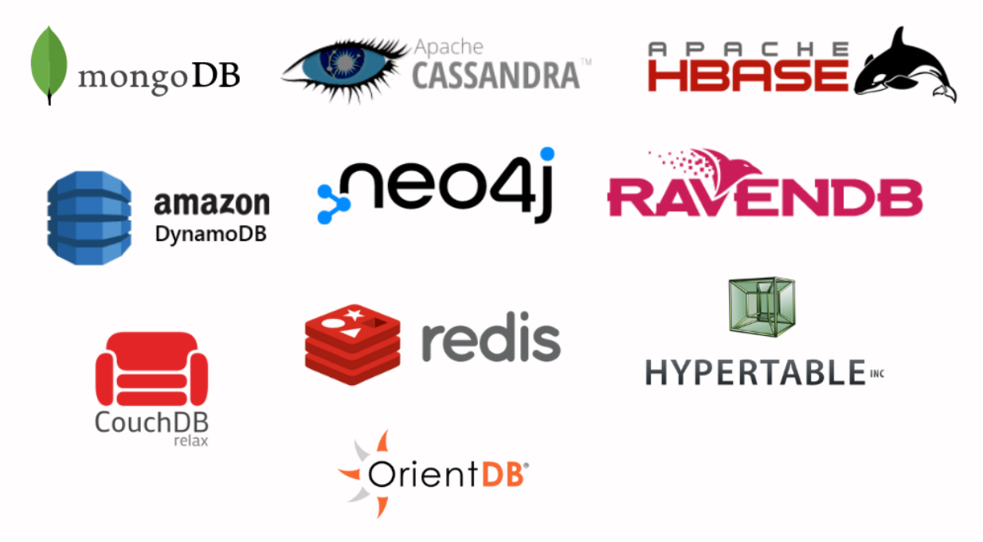
Top 10 NoSQL DB’s
Source: https://www.decipherzone.com/blog-detail/nosql-databases

Slide 11
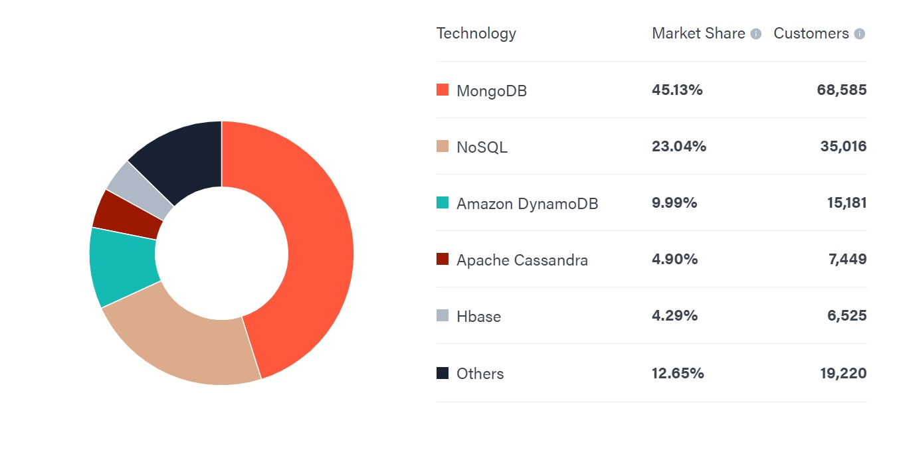
MongoDB Vs Other NoSQL DB's
As at 2nd December 2023, Mongo DB ranks 1st among most used NoSQL database management systems worldwide with a Market share of 45.13% and 68,585 customers.
Source: https://6sense.com/tech/nosql-databases

Slide 12
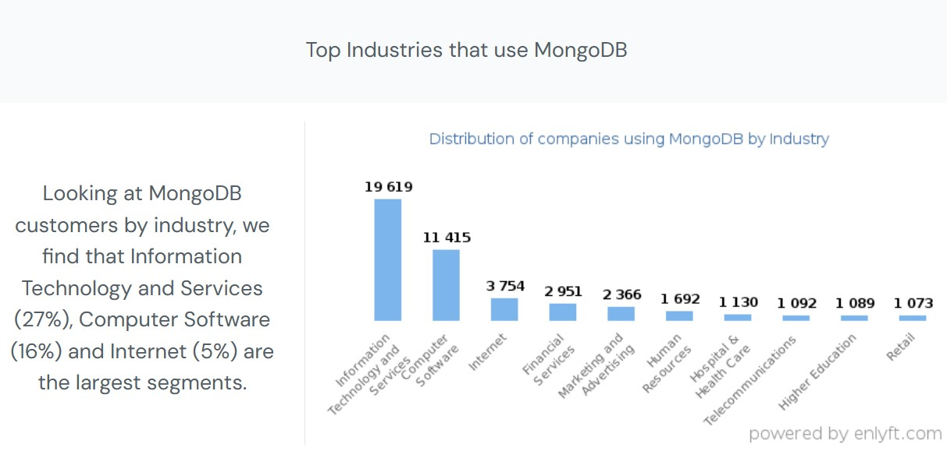
MongoDB Customer Distribution By Industry

Slide 13
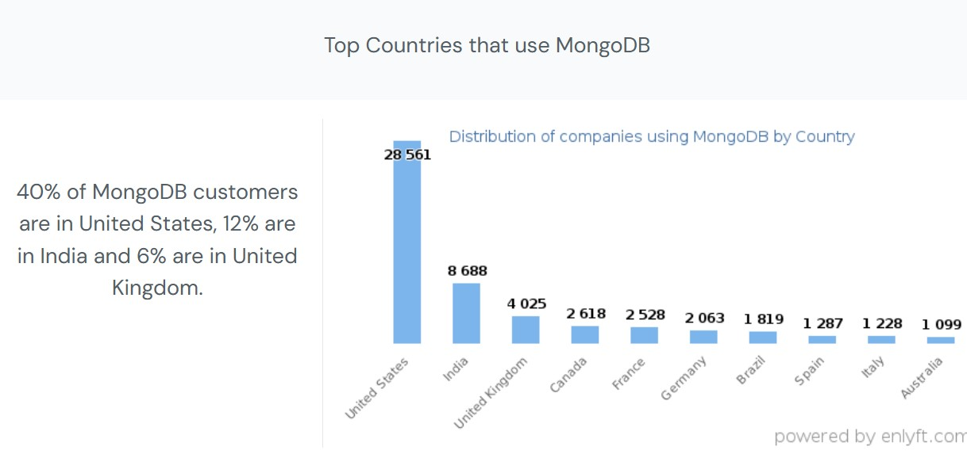
MongoDB Customer Distribution By Geography

Slide 14

Phase III
MongoDB Vs Other NoSQL DB’s

Slide 15
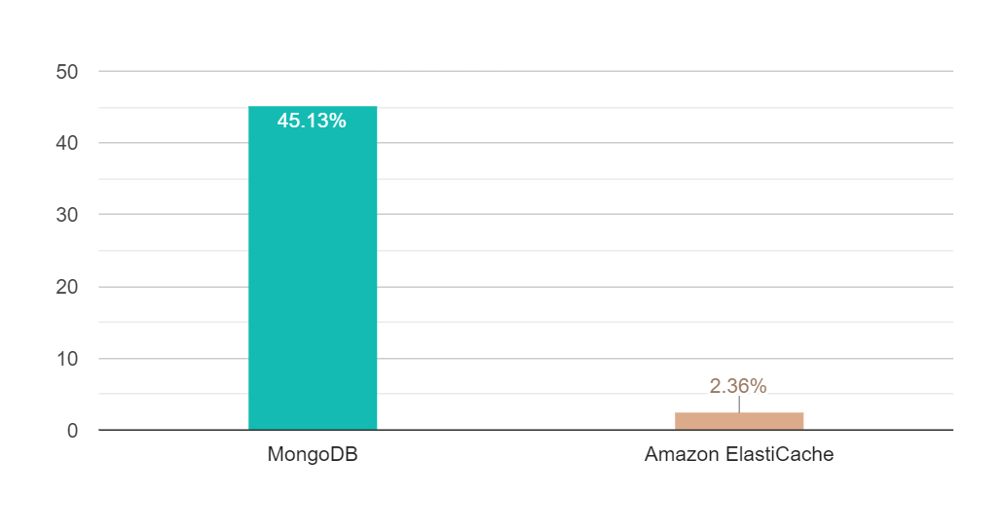
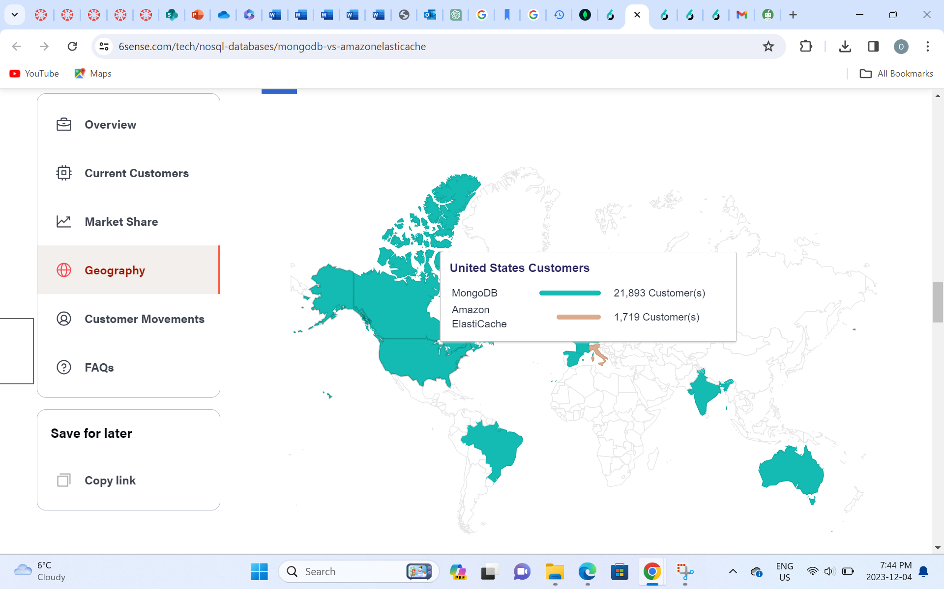
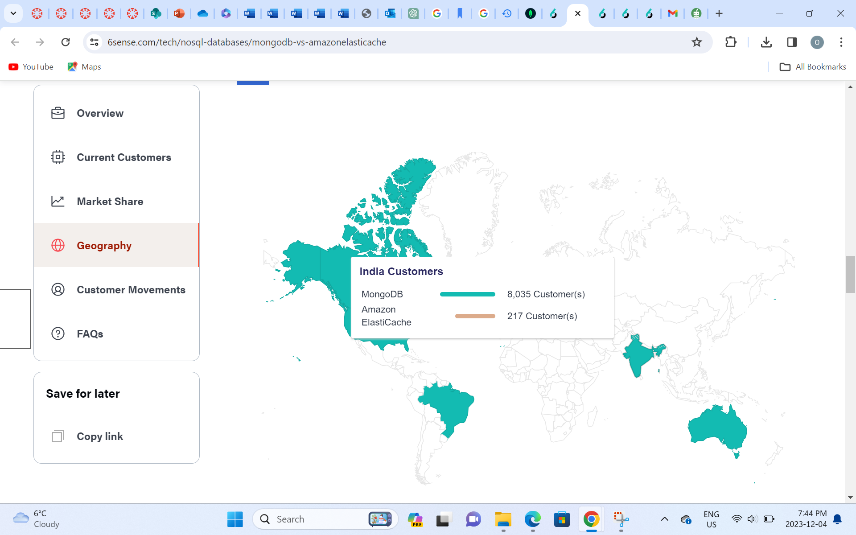
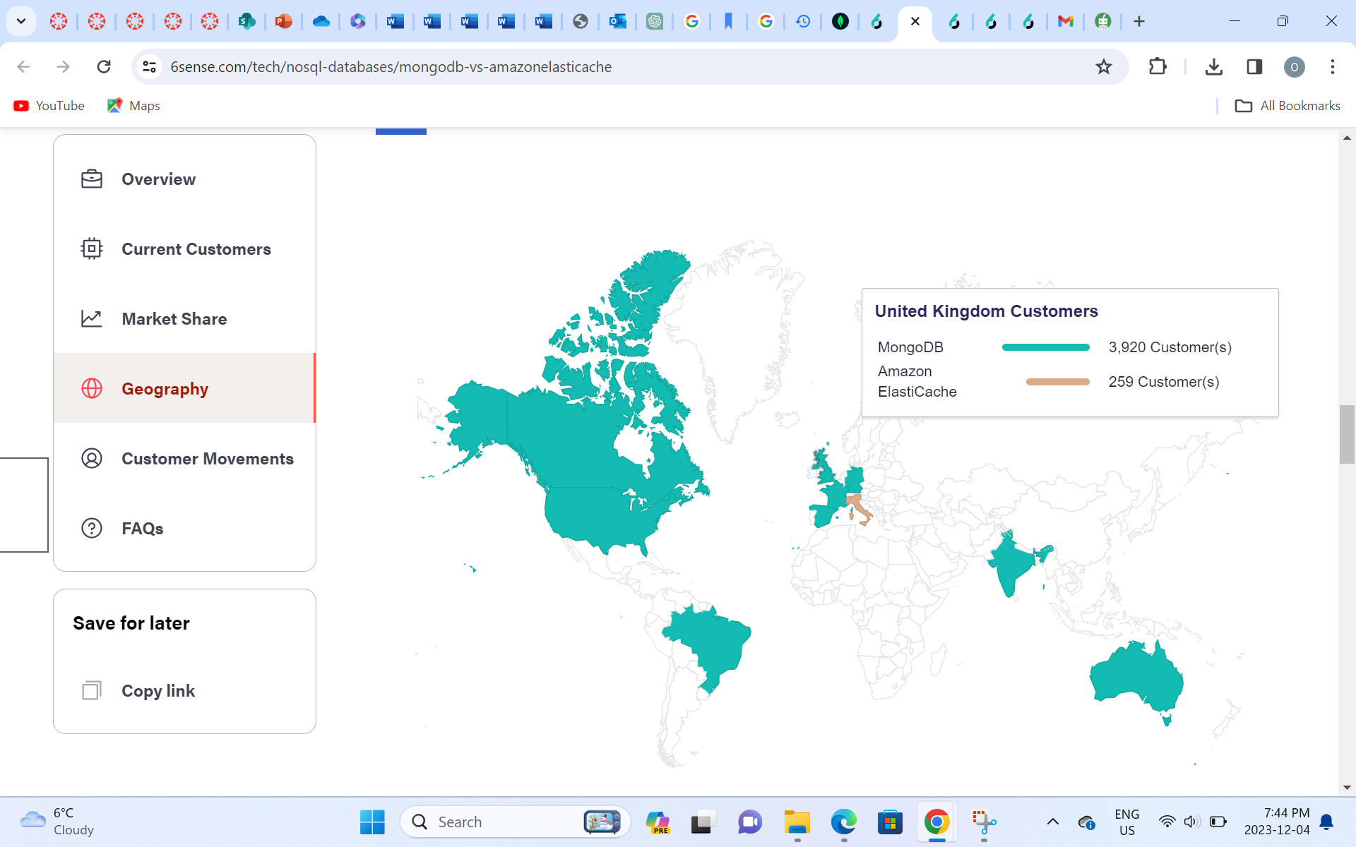
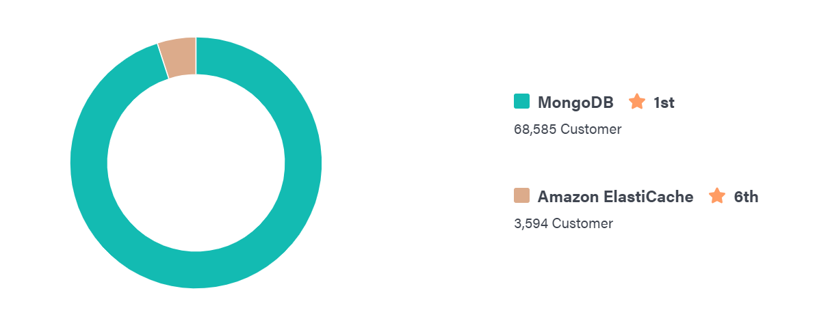
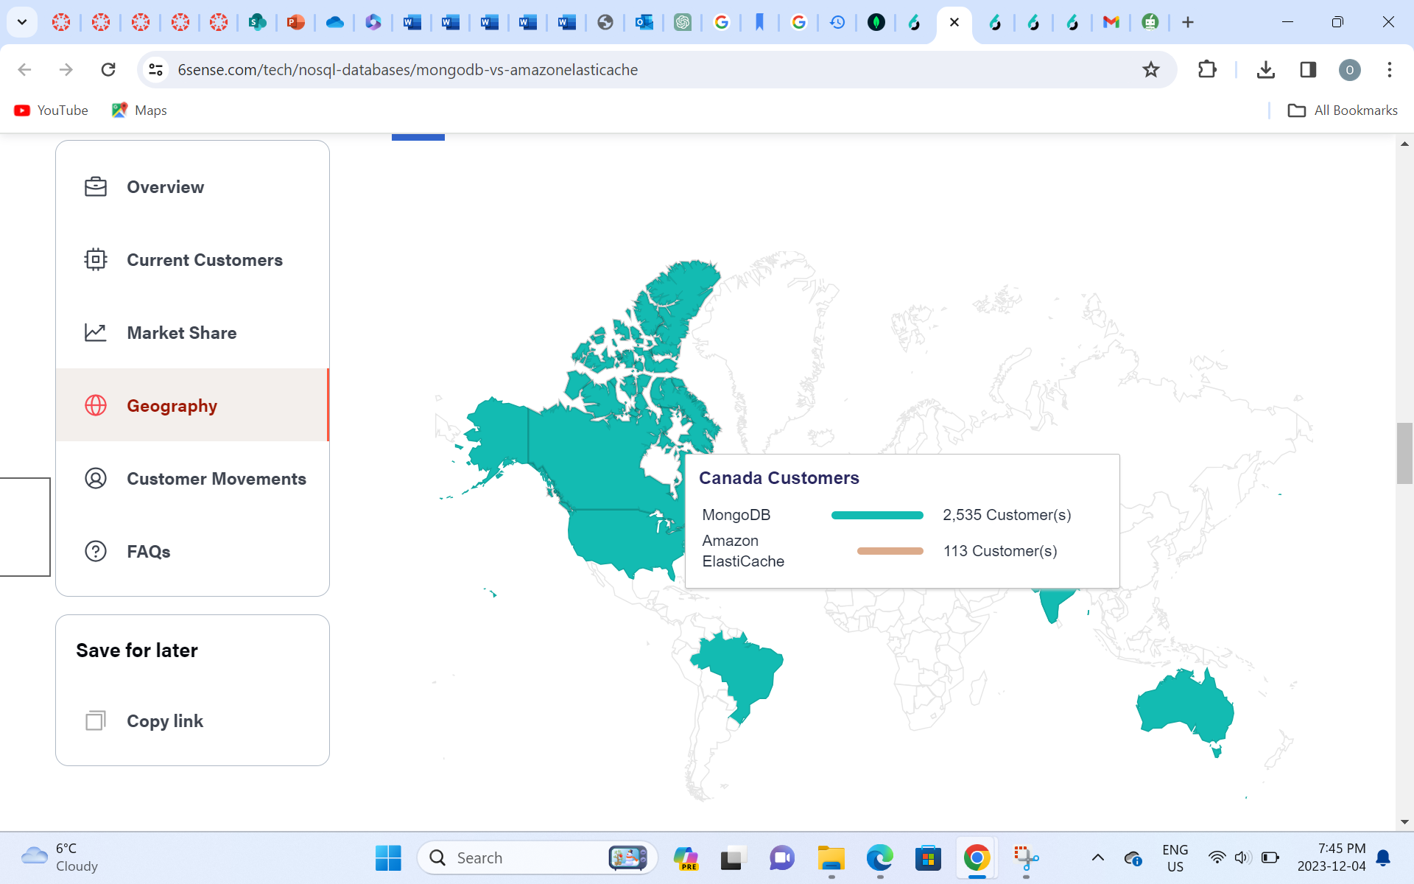
MongoDB Vs Amazon ElastiCache
Source: https://6sense.com/tech/nosql-databases/mongodb-vs-amazonelasticache

Slide 16
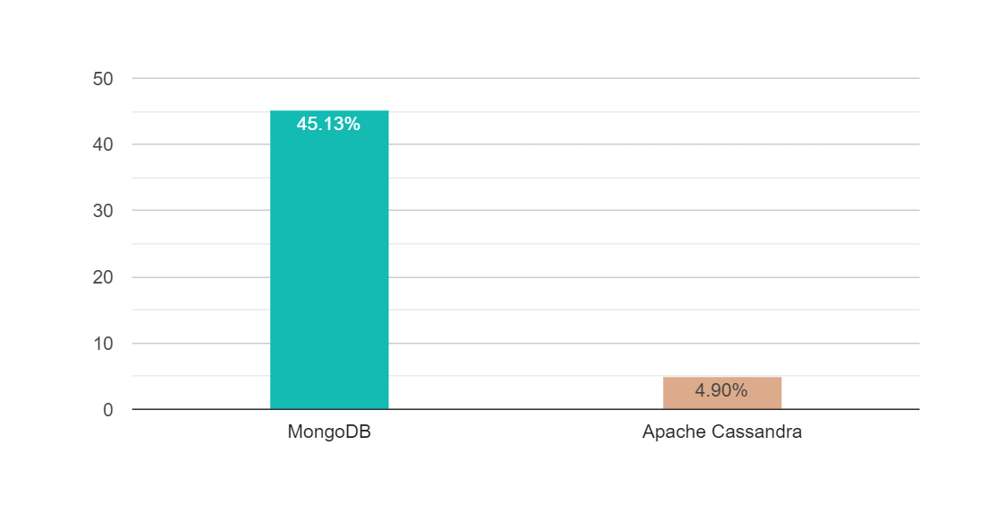
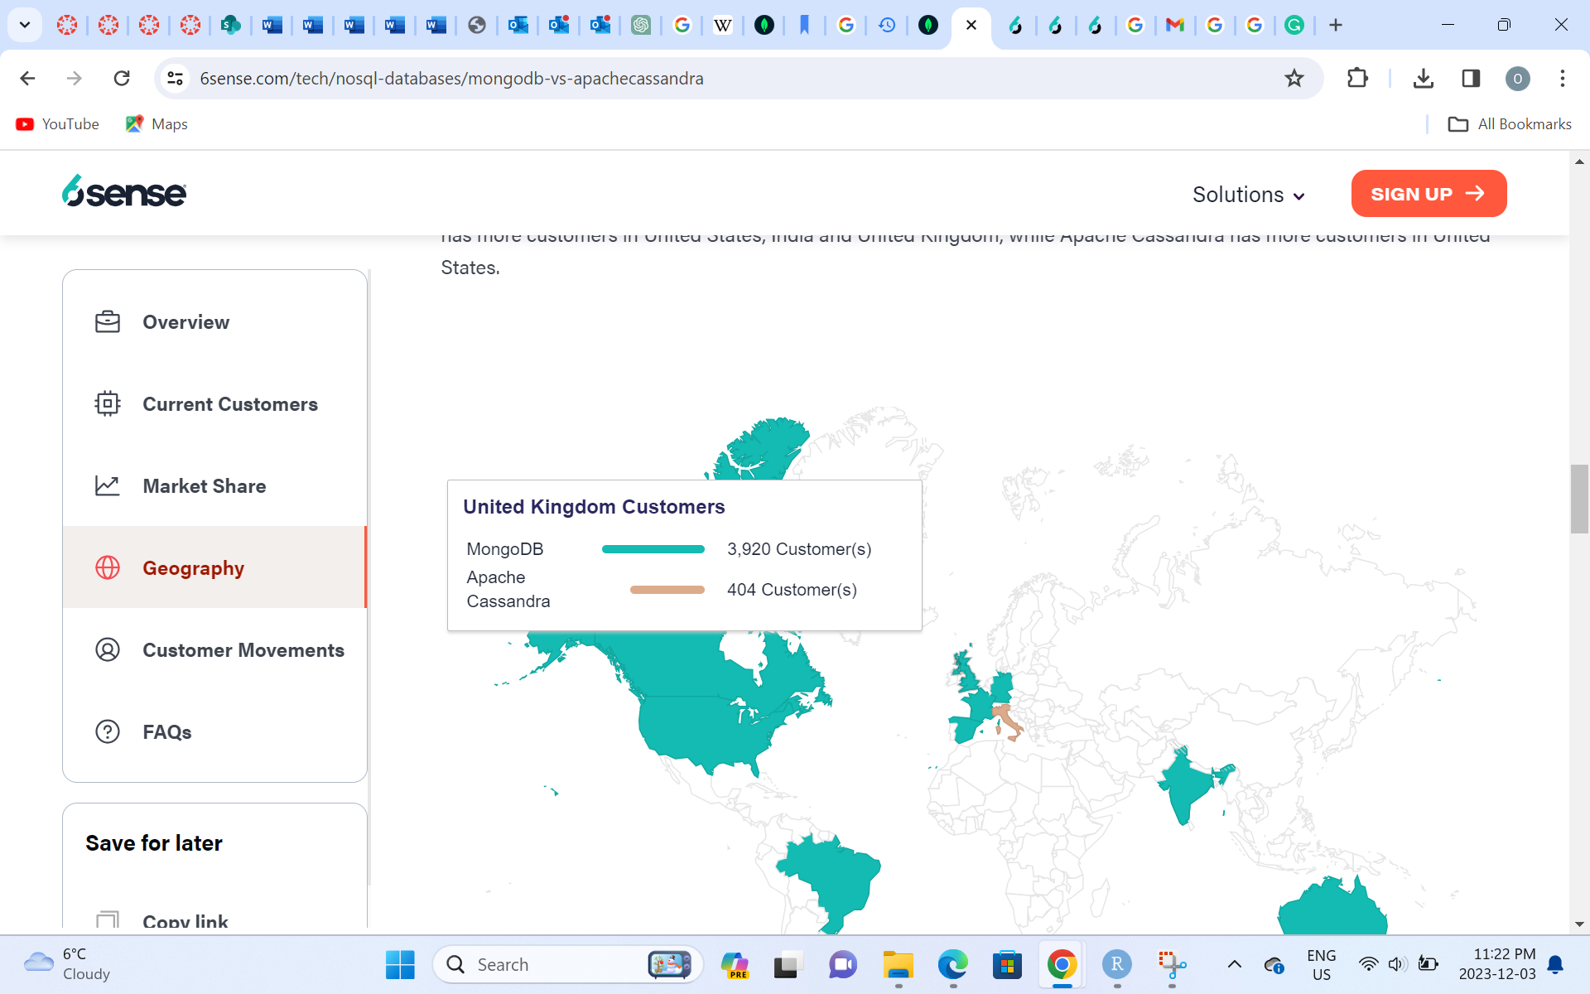
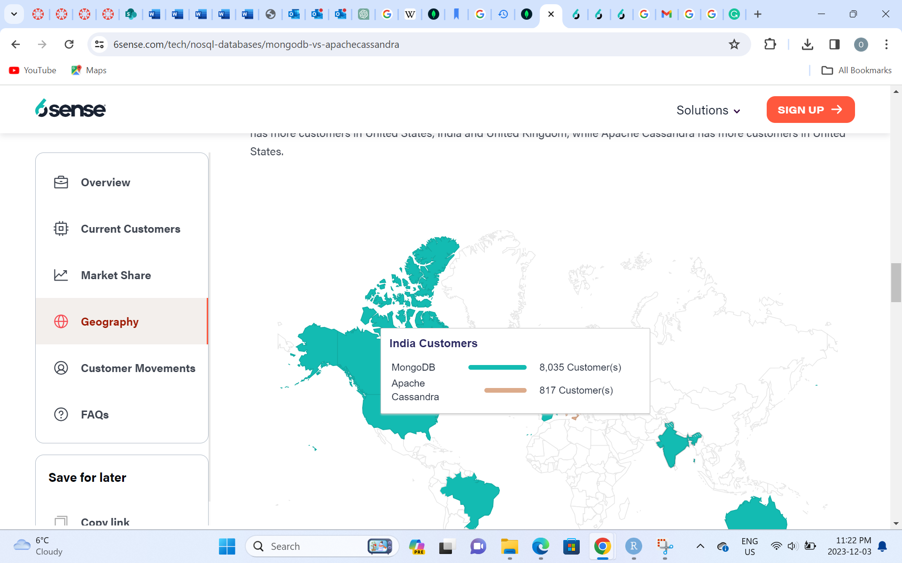
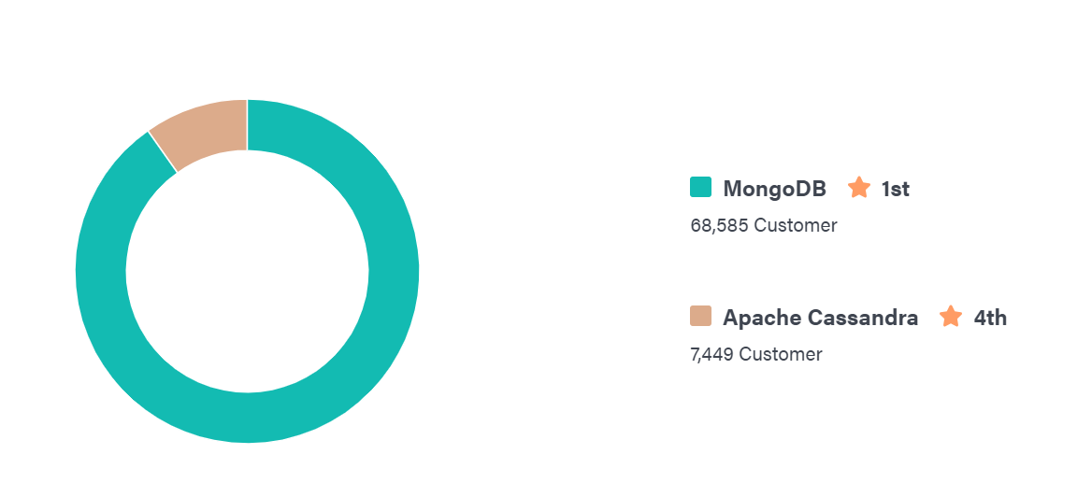
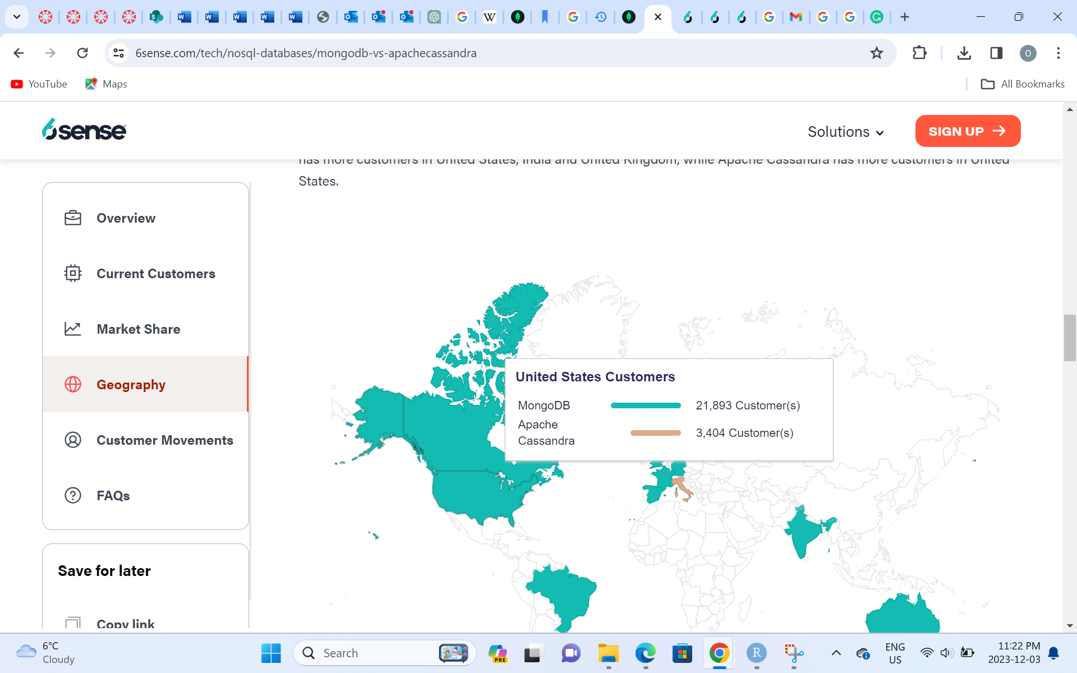
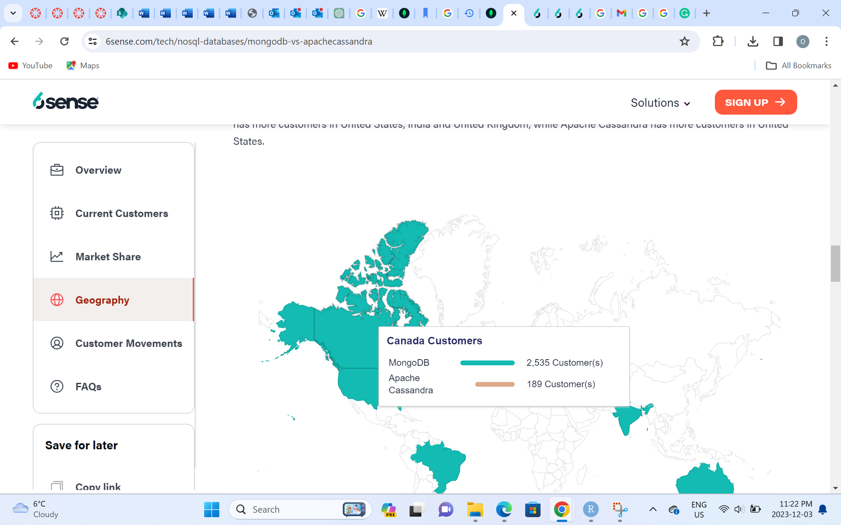
MongoDB Vs Apache Cassandra
Source: https://6sense.com/tech/nosql-databases/mongodb-vs-apachecassandra

Slide 17
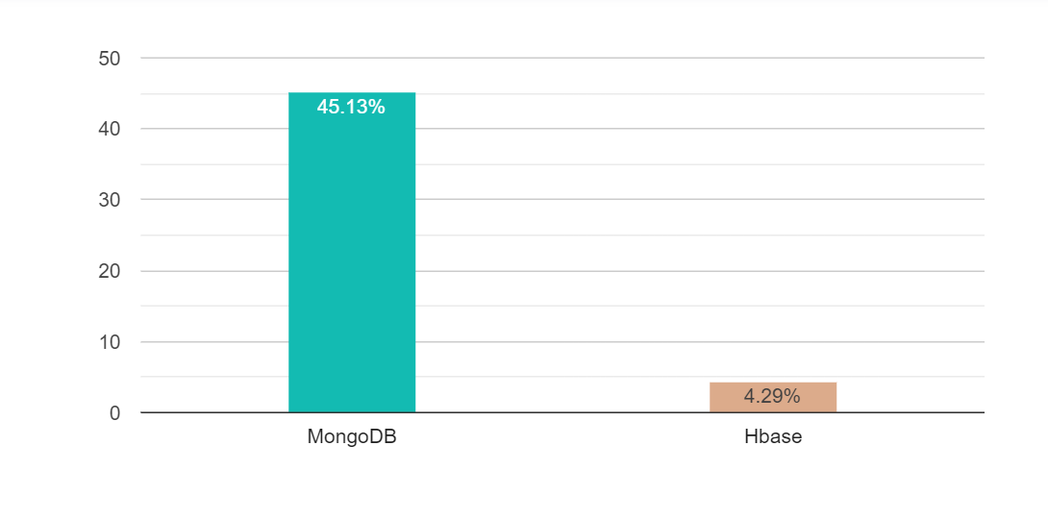
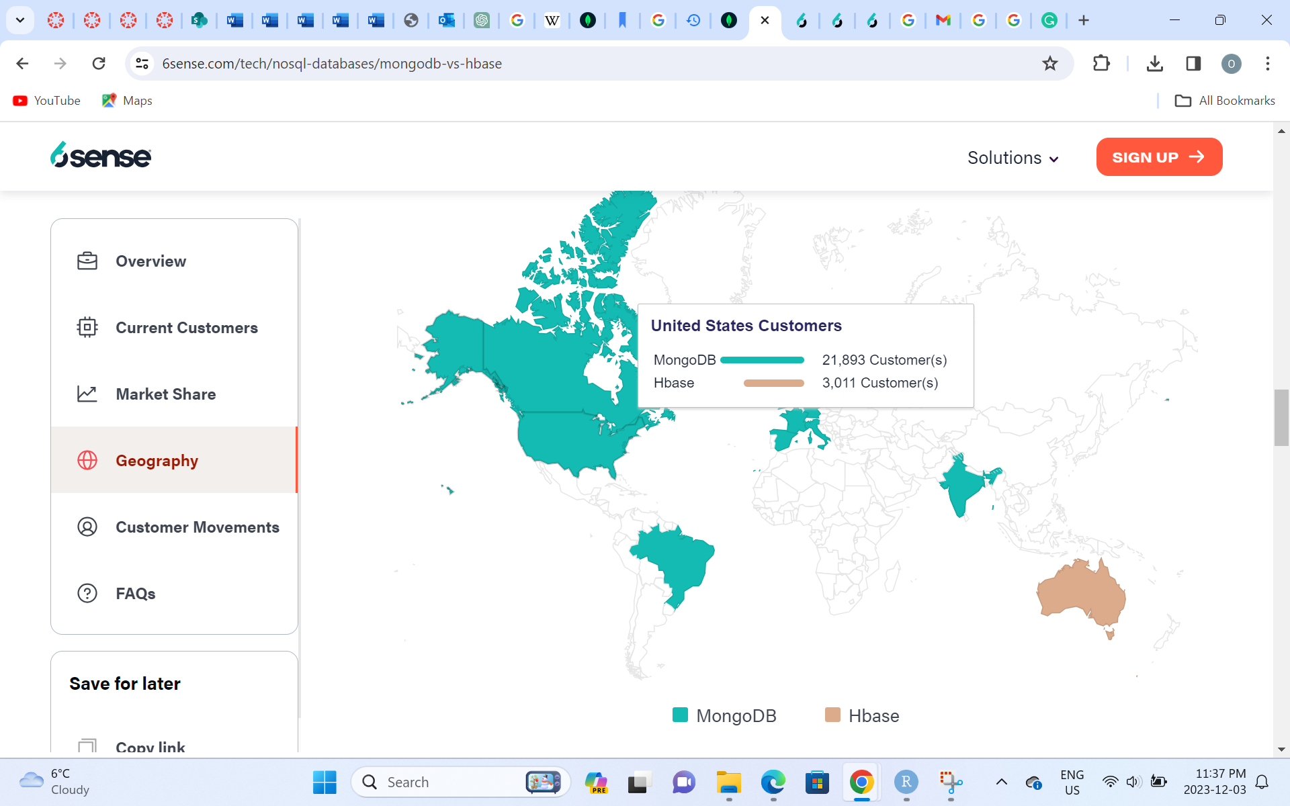
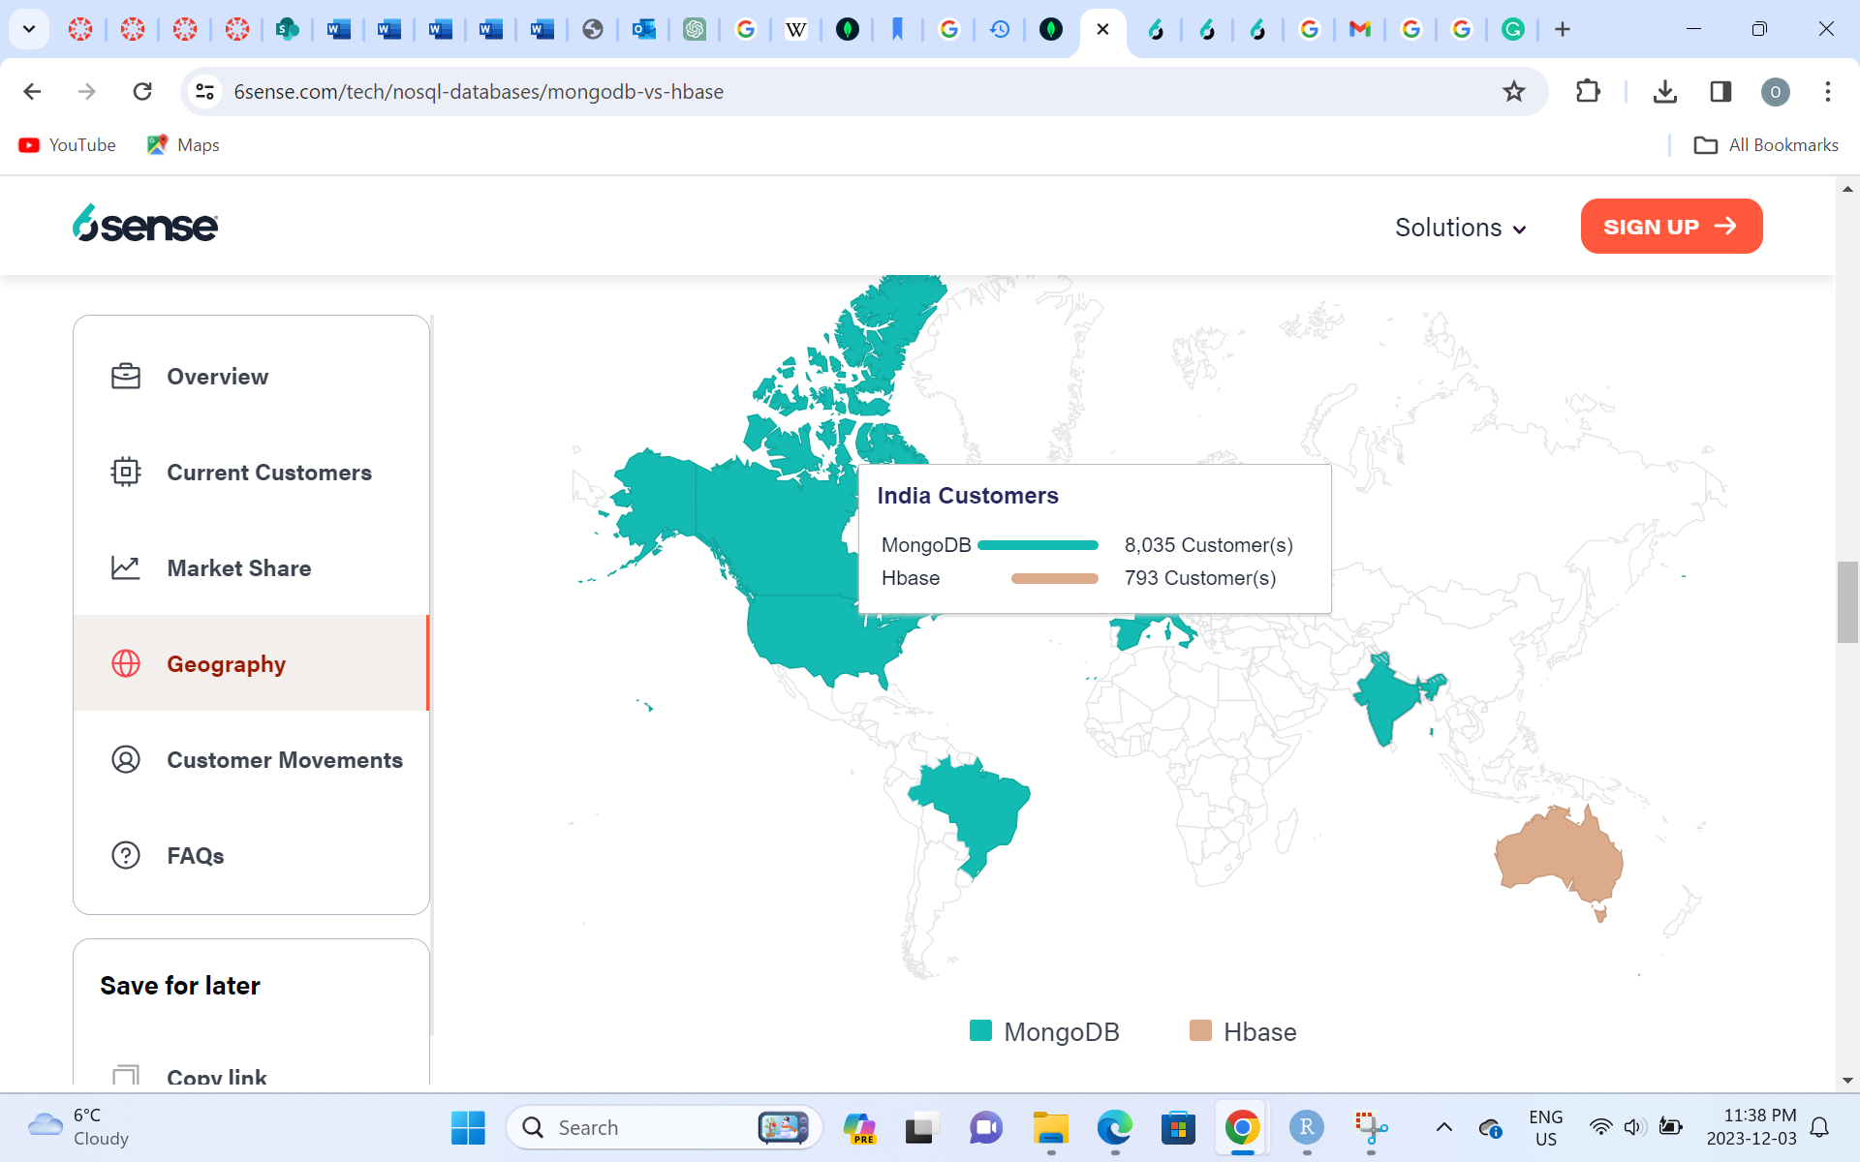
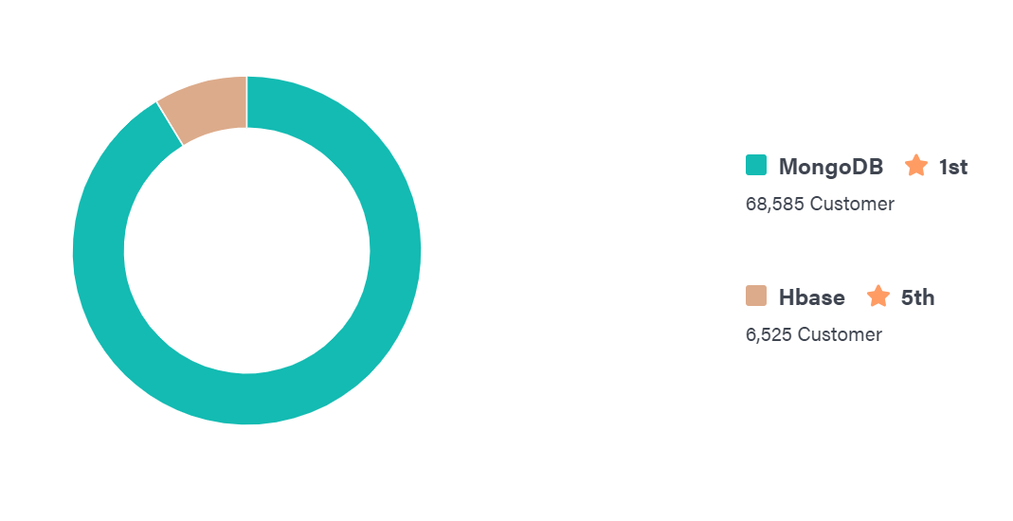
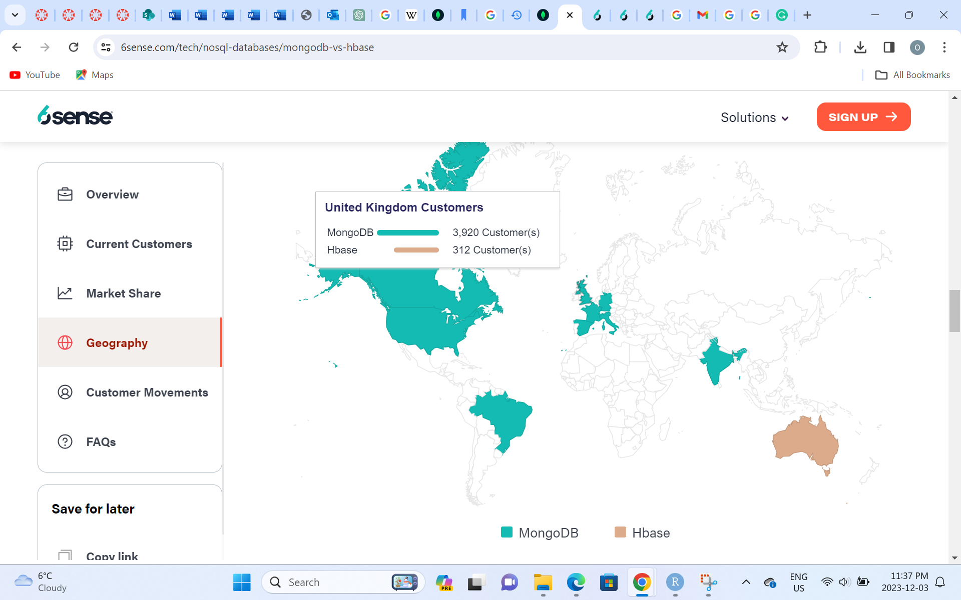

MongoDB Vs Hbase
Source: https://6sense.com/tech/nosql-databases/mongodb-vs-hbase

Slide 18
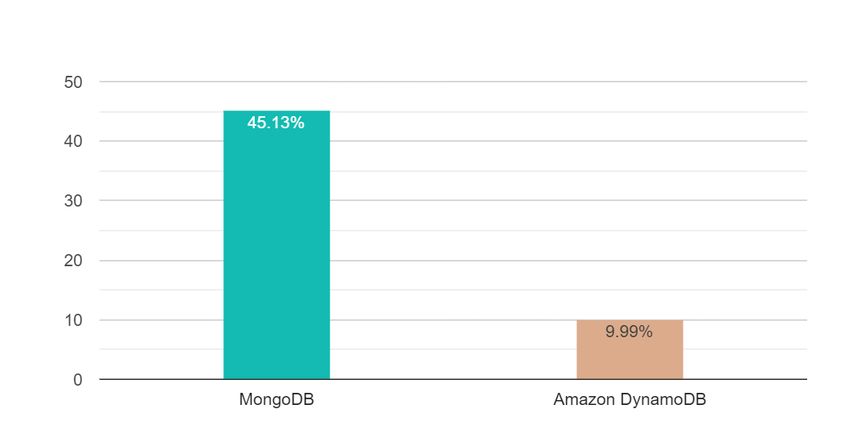
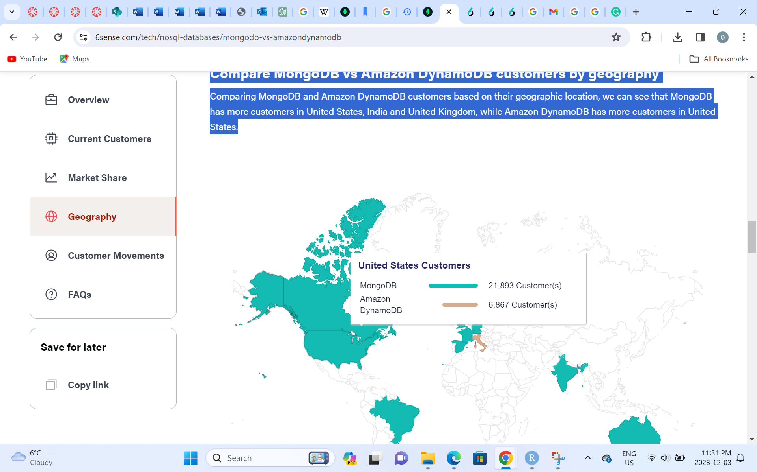
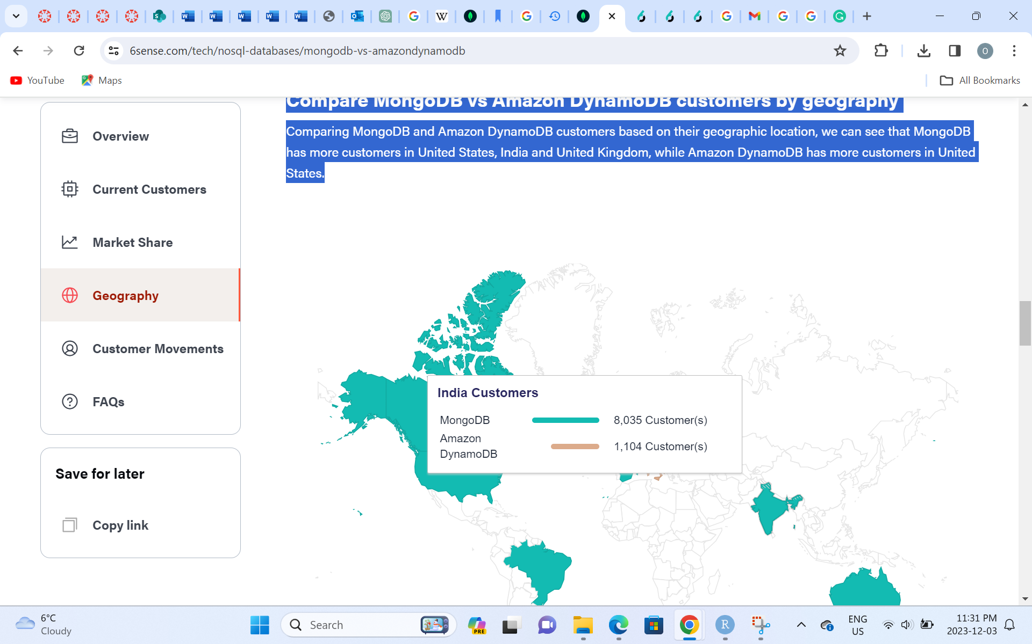
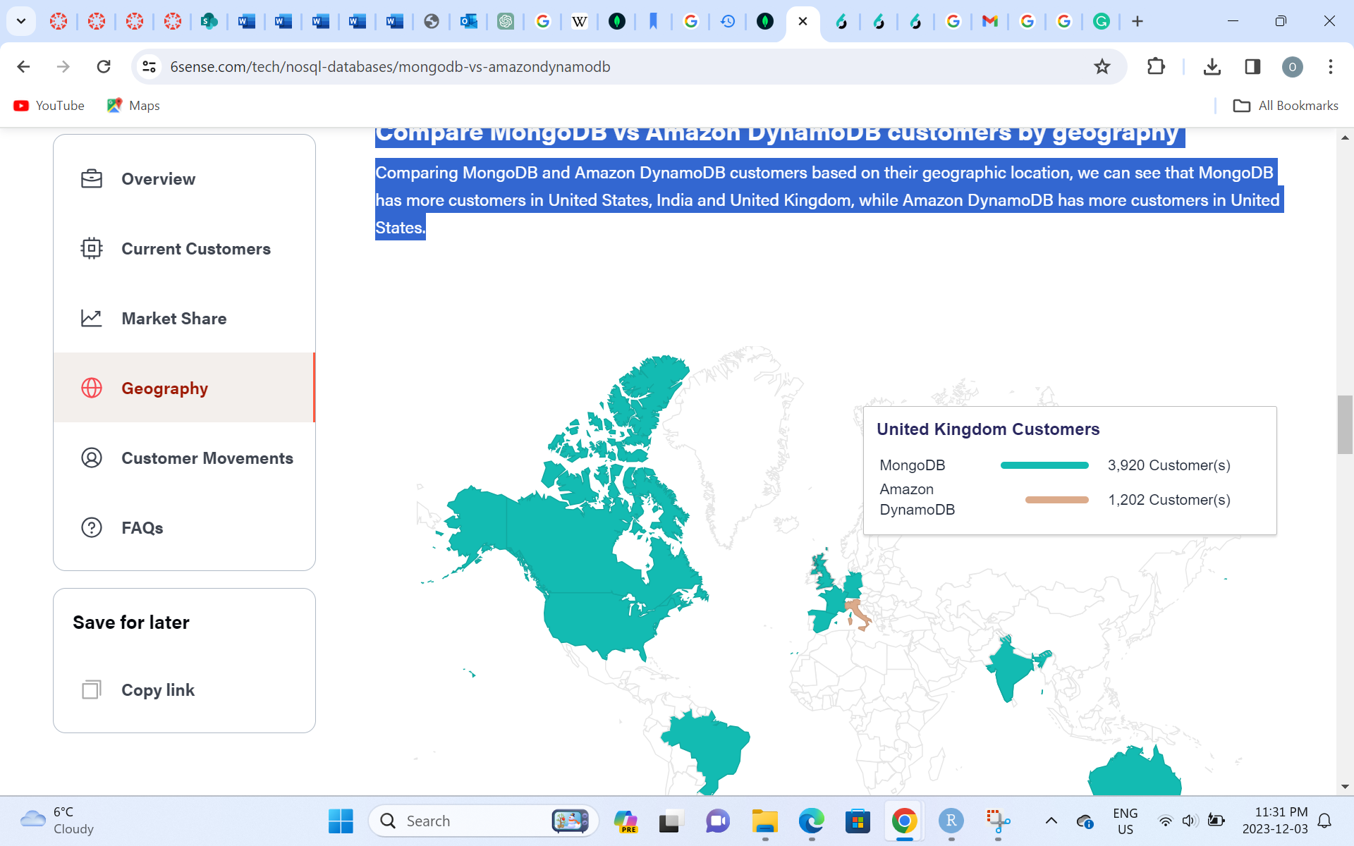
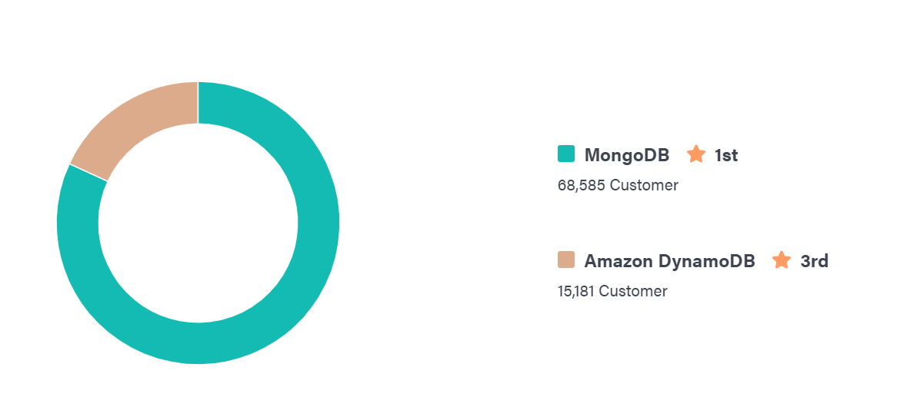
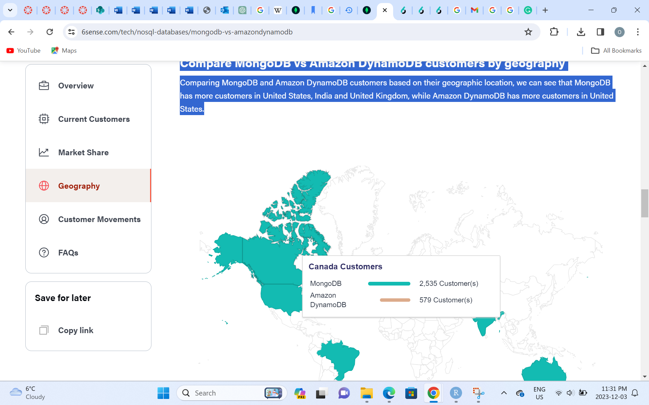
MongoDB Vs Amazon DynamoDB
Source: https://6sense.com/tech/nosql-databases/mongodb-vs-amazondynamodb

Slide 19
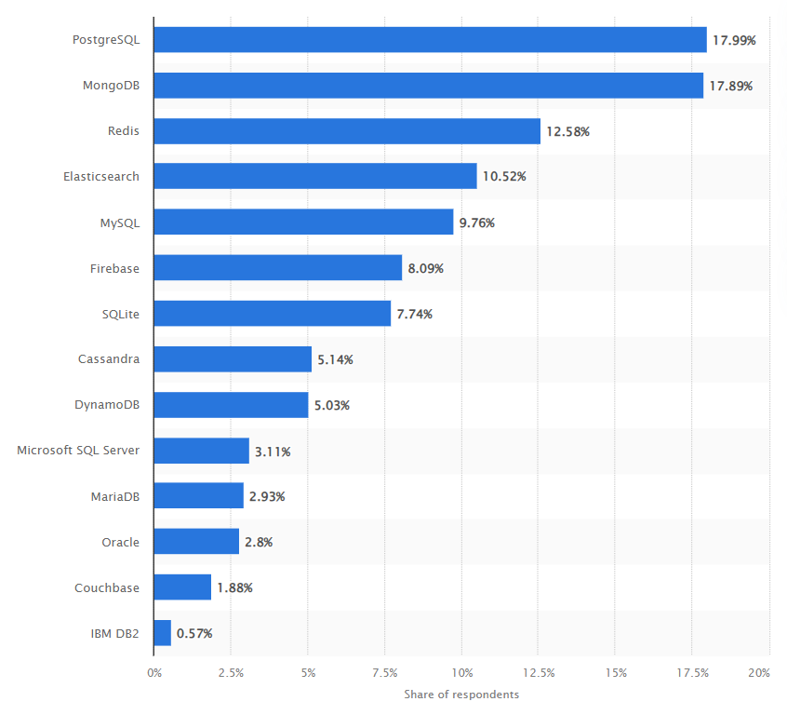
Most Wanted Database Skills
MongoDB ranked 2nd at Most wanted database skills among software developers worldwide as of 2021 Source: https://www.statista.com/statistics/793854/worldwide-developer-survey-most-wanted-database/

Slide 20
Conclusion
MongoDB ranks 5th among the databases and 1st among the NoSQL databases.
It is widely used among software developers and it should be in your toolbox if you are a software developer who wants to work in the USA, UK, and Canada.
It works well with unstructured data for Big Data Systems, News Site Forums, and social networking applications.
It works well with cloud computing.

Slide 21
Reference
About Us. (n.d.). MongoDB. https://www.mongodb.com/company#:~:text=MongoDB%20was%20founded%20in%202007
MongoDB. (2023, November 30). Wikipedia. https://en.wikipedia.org/wiki/MongoDB#:~:text=History
Ultimate Guide MongoDB: Definition, Advantages & Disadvantages. (n.d.). Knowledgenile. https://www.knowledgenile.com/blogs/pros-and-cons-of-mongodb
MongoDB pros and cons: tips and advice from real users 2023 | PeerSpot. (n.d.). Www.peerspot.com. Retrieved December 4, 2023, from https://www.peerspot.com/products/mongodb-pros-and-cons
Wikipedia Contributors. (2019, October 31). MongoDB. Wikipedia; Wikimedia Foundation. https://en.wikipedia.org/wiki/MongoDB

Slide 22
THE END

